Slide 1
Universal Credit: designing and implementing the UK’s new working-age benefit and how this differs from Basic Income Jane Millar November 2019 j.i.millar@bath.ac.uk
Making Basic Income a European Reality, Tampere

Slide 2
Overview
1. What is Universal Credit?
2. How is Universal Credit working?
3. Universal Credit and Universal Basic Income

Slide 3
2010 White Paper: ‘Universal Credit: welfare that works’
”Universal Credit is an integrated working-age credit … It will support people both in and out of work, replacing Working Tax Credit, Child Tax Credit, Housing Benefit, Income Support, income-based Jobseeker’s Allowance and income-related Employment and Support Allowance.”
Rolls six means-tested benefits into one
But does not include all benefits

Slide 4
A simpler structure which will …
Support work:
smooth the transition to work
make all work pay, including mini jobs
reduce high marginal tax rates
And improve delivery:
simplify the system, easier to understand, easier & cheaper to administer
Reduce fraud and error
Improve take-up
And transform welfare state:
For jobcentres, local authorities, local partnerships, employers
For individuals, “no longer trapping people in dependency but providing the incentive and support to secure a better future for themselves and their families”

Slide 5
At start: general support for the principle
‘The principles behind Universal Credit have widespread support, which we share. The Government has made significant progress in designing a system which will help ease the transition from benefits to work’
HC Work and Pensions Select Committee, 2012
‘JRF supports the principles behind UC, of simplifying the welfare system and of making work pay.’
Goulden, 2015, for Joseph Rowntree Foundation
Notes:
Jane

Slide 6
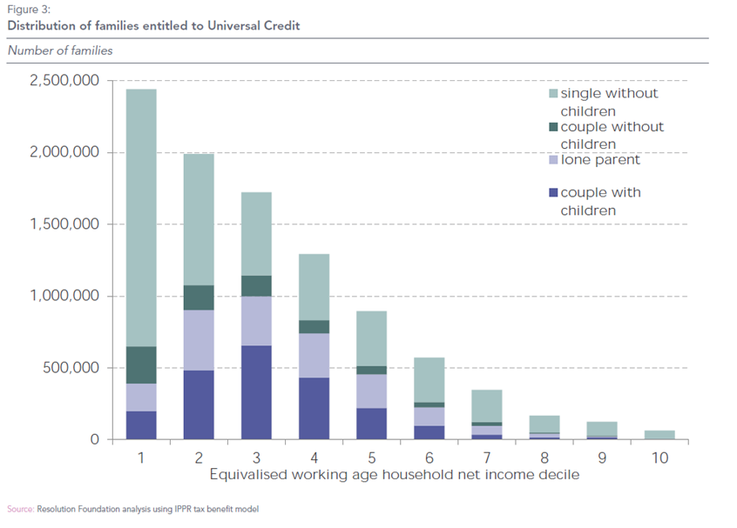
Scope: About 7 million households
NB- initial estimates, not taking account of UC policy changes
Costs: ‘At a cost of more than £60 billion a year it will make up around a quarter of all welfare spending and around two-thirds of working-age welfare spending’. Office for Budget Responsibility, 2018

Slide 7
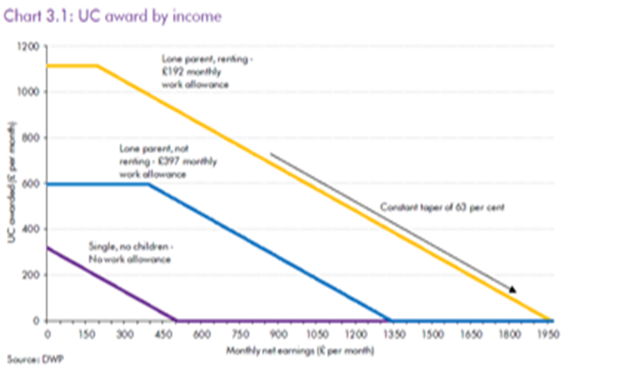
Design: key features
A basic amount plus amounts for children, disability, caring for a severely disabled person, housing costs, part of childcare costs
Supporting and mandating work: the ‘claimant commitment’, includes people in work
Means-test design aims to be ‘like work’: monthly assessment & single monthly payment
Financial incentives: work allowance (for some) & single taper (currently 63%)

Slide 8
Delivery
DWP
Digital system – online application & claim management
Work coaches – extended role for DWP front line
Others
Local authorities/Housing Associations
Citizen’s Advice – Help to claim
Universal Credit Transition Fund

Slide 9
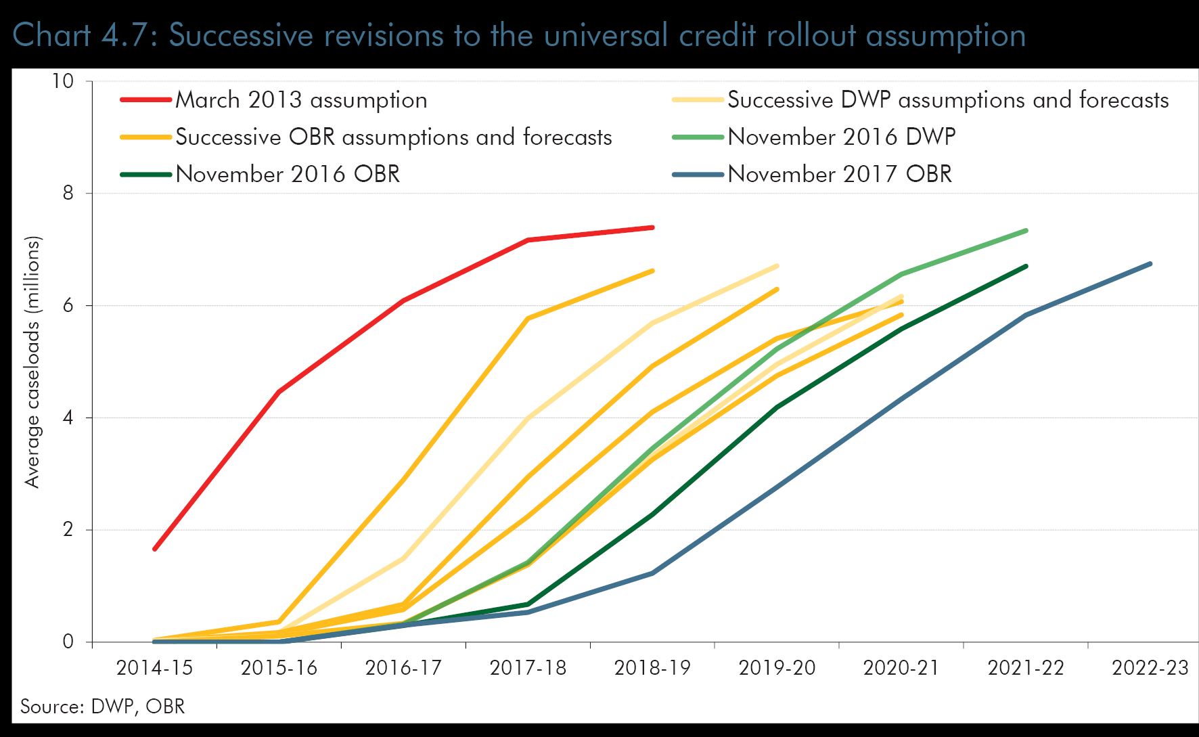
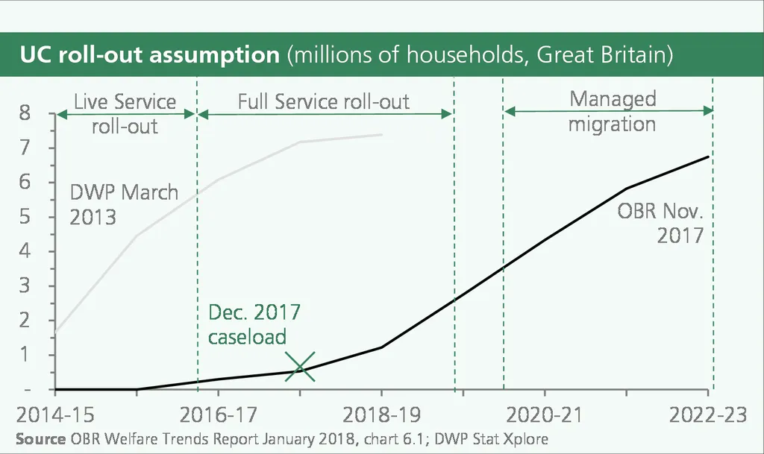
Delivery: slow roll-out
Announced in 2010, started 2013
Roll out in stages, timetable revised several times, to 2023
‘Natural and managed migration
July 2019: 2.3million people, 1.8million households, 57% no children 32% lone parents, 11% couples with children. About one-third are in work.
LONG WAY STILL TO GO

Slide 10
Changing context
Austerity
Benefit freeze, 2016-2020, in the level of most means-tested benefits for working-age people
Other restrictions: benefit cap, ‘bedroom tax’, two-child limit, cuts in premiums
Labour market
Employment up, unemployment down, wages static, job insecurity up
DWP Leadership
Seven people in post of Secretary of State since 2010

Slide 11
The evidence so far- main sources:
DWP: evaluation and administrative data
‘On-the-ground’ evidence: often via organisations advising & supporting claimants (CPAG, Trussell) or involved (Housing Associations, Citizens Advice)
Independent research – mostly still ongoing
Media, including social media – very active, partial but strong framing
… still very patchy …

Slide 12
National Audit Office 2018: summary
Current experience
Claimant satisfaction much the same as legacy benefits, good relationships between work coaches and claimants
Some claimants struggling to access, delays in payments, hardship and limited help
Extra costs falling on local organisations
Future prospects
Lots to do to improve efficiency
Lots still unknown about impact
Will ‘never be able to measure’ employment outcomes
It is ‘not value for money now and its future value for money is unproven’.

Slide 13
UN Special Rapporteur extreme poverty and human rights Universal Credit 2018
“No single program embodies the combination of the benefits reforms and the promotion of austerity programs more than Universal Credit. Although in its initial conception it represented a potentially major improvement in the system, it is fast falling into Universal Discredit ….
Issue identified include the 5 week wait, deductions, pointless job applications, digital by design, lack of transparency, hard to appeal, sanctions
“As I spoke with local authorities and the voluntary sector about their preparations for the future rollout of Universal Credit, I was struck by how much their mobilization resembled the sort of activity one might expect for an impending natural disaster or health epidemic. They have expended significant expense and energy to protect people from what is supposed to be a support system.”

Slide 14
No shortage of critiques & ideas for reform…
Political Parties
Manifestos to come…
All Party Parliamentary group – major reforms
NGOs/Think Tanks
Citizen’s Advice Bureau
Child Poverty Action Group
Resolution Foundation
Social Market Foundation
Bright Blue
Popular press campaigns, eg
The Sun –make Universal Credit work
The Daily Mirror – stop the roll out
Trade Unions
TUC – Stop and Scrap
Unite the Union – STOP Universal Credit
Social Media, eg
Universal Credit Sufferer
Facebook: Universal Credit Survival Open Group UK
Notes:
Goals of tacking in-work poverty and improving work incentives look to be severely compromised, especially for lone parents and second earners

Slide 15
Future …..?
Teething problems – will it settle down?
Managed migration still to come – more issues and bad publicity?
Too big to fail?
Is it fit for (future) purpose – labour market, in-work progression, gender roles?

Slide 16
UC & UBI: some similarities in rationale & aims …
Need to adapt social security to:
Increasingly insecure labour market, movements in & out of work
In-work poverty – low pay & irregular pay
Need to make social security:
Simpler to understand
Easier to access
Simpler to administer
One benefit for working-age people,
not dependent on labour market status

Slide 17
But important differences in structure:
Basic Income (BIEN definition) | Universal Credit
Periodic: paid at regular intervals | √
2. Cash payment | √
3. Individual: not household or family | x
4. Universal: to all with no means-test /capital-test | x
5. Unconditional: no requirement to work/seek work | x
Single administrative system | √
Guaranteed minimum | x

Slide 18
“..the biggest change programme in Europe..”
DO NOT
Introduce at the same time as austerity, cuts in benefits
Underestimate the challenges of getting people into the system
Assume IT can solve all problems, eg verification of identity
Underestimate the need for effective and ongoing communication strategy
CHALLENGES
Single payment – all eggs in one basket, what to do when this fails?
Choices about roll-out – UK ‘single simples’ in specified areas; ‘test and learn’ but no pilot of the administration
Responsiveness to changes in income & circumstances – could be an issue for some forms of BI?
Difference between being only source of income (when out of work) and being part of income (when in work)

Slide 19
Some references
Department for work and Pensions
(2010) Universal Credit: Welfare that works
(2018) Universal Credit Full Service Survey
(2018) Universal Credit programme full Business Case
(2018) Universal Credit: In-Work Progression Randomised Controlled Trial
Office for Budget Responsibility (2018) Welfare trends report,
Equality and Human Rights Commission (2018) The cumulative impact of tax and welfare reforms
National Audit Office (2018) Rolling out Universal Credit
Public Accounts Select Committee (2018) Universal Credit
Revenue Benefits
Child Poverty Action Group
Work and Pensions Committee (2018) Universal Credit Project Assessment Reviews
House of Commons Library (various)
Universal Credit statistics
Some blogs
Jane Millar, Universal Credit managed migration: the next big challenge (2018)
Alison Garnham (CPAG), Universal Credit discriminates against women by design (2018)
David Finch (Resolution Foundation), With the benefits of benefit reform diminishing, Universal Credit needs a new direction (2018)
Jane Millar, Universal Credit. Can we fix it? Should we fix it? (2017)
Jane Millar & Fran Bennett, Giving back control? A contradiction at the heart of Universal Credit. (2016)

